Slide 1
AlphaFold Decoded with OpenFold Weights
October 23, 2026
Notes:
Today I’ll walk through a notebook that takes a protein from a set of related sequences all the way to a predicted 3D structure, using AlphaFold2. The protein we’ll use is ubiquitin, a small protein that is almost identical across species, which makes it a good test case.
The notebook runs AlphaFold-style code called alphafold-decoded, a teaching version of AlphaFold2, filled in with trained weights from OpenFold. OpenFold is an open-source re-creation of AlphaFold2, and its team published their own set.
Practice notes: Include what openfold weights is before going forward
OpenFold weights, in plain words: a model's 'weights' are the numbers it learns during training, and they are what lets it predict structures. OpenFold is an open-source re-creation of AlphaFold2, and its team trained and published their own set of weights. This notebook uses AlphaFold-style code (the alphafold-decoded teaching version) filled in with those trained numbers.
Note/Suggestions:
Introduce the molecule – what it is/structure and why it is important
Saying how it is conserved and maybe show alphafold prediction – show related homologs
Maybe align the MSA (Pfam)
Seed vs full and how there is diversity and such
Take out blossom, she isn’t
If keeping DCA explain it, also explain MI from the alignment
She just says to keep the mutual information

Slide 2
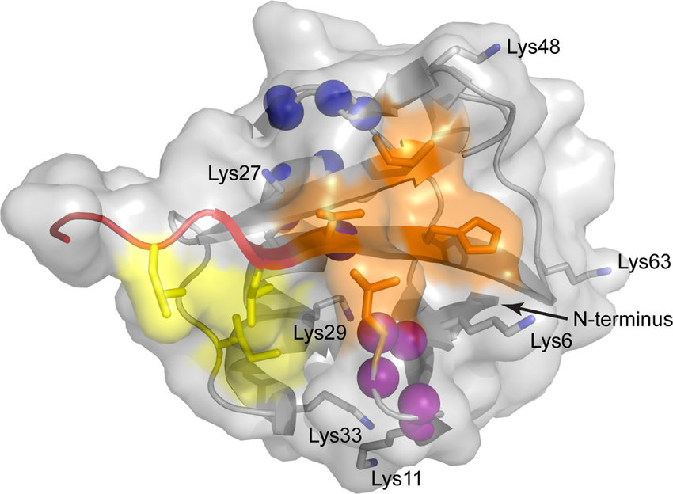
Ubiquitin
Ubiquitin is a small (8.6 kDa) regulatory protein
Key features include its C-terminal tail and the 7 lysine residues.
Diagram of Ubiquitin and its surface representation.
Notes:
Position 19: Occupied by proline in mammals/animals, but substituted with serine in plants (like oat) and yeast. Position 24: Occupied by glutamic acid in mammals, but substituted with aspartic acid in plants and yeast. Position 28: Occupied by alanine in mammals and plants, but substituted with serine in yeast.
The 2004 Nobel Prize in Chemistry was awarded to three researchers who discovered its essential function in 1980

Slide 3
Ubiquitin
Defects in ubiquitin signaling is linked to cancer, neurodegeneration, and immune dysfunction
It is found in every organism with complex cells, from yeast to humans
  Only three positions in the Ub structure differ among mammals, yeast, and plants. Has a large family of related proteins.
Diagram of Ubiquitin and its surface representation.
Notes:
Position 19: Occupied by proline in mammals/animals, but substituted with serine in plants (like oat) and yeast. Position 24: Occupied by glutamic acid in mammals, but substituted with aspartic acid in plants and yeast. Position 28: Occupied by alanine in mammals and plants, but substituted with serine in yeast.
The 2004 Nobel Prize in Chemistry was awarded to three researchers who discovered its essential function in 1980

Slide 4
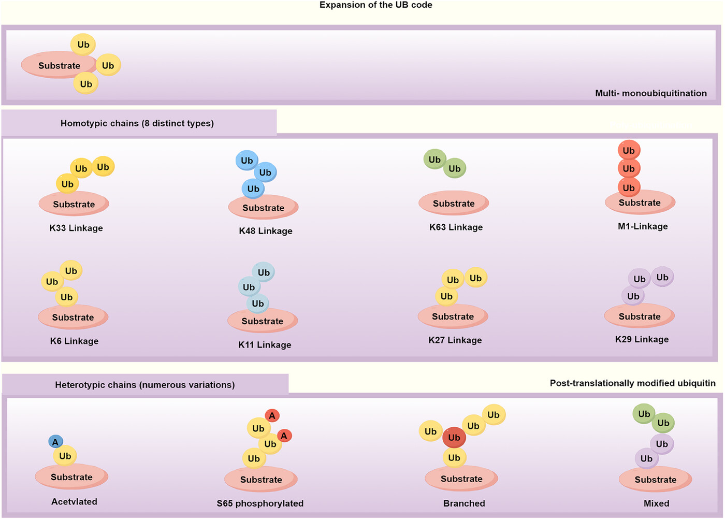
Conservation of Protein Structure
The C‑terminal tail is the site of covalent attachment to substrate proteins
The seven lysines act as docking sites that determine the type of ubiquitin signal.
Notes:
So before we get too much into what the protein does, we want to look at the structure more. As the protein does not significantly vary, being nearly identical between species, that does indicate that structural properties of it play significant roles. The C terminal tail are used as a site of covalent attachment between it and other proteins. The second thing of interest is the seven lysines, which enable various docking interactions and the formation of polyubiquitin chains.

Slide 5
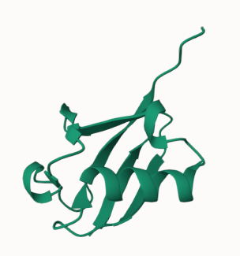
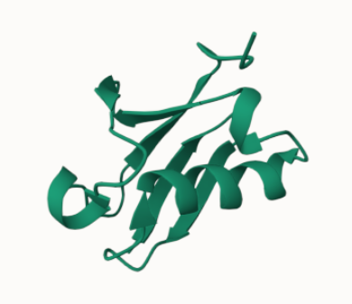
Ubiquitin
Ubiquitin-like domain of FUBI
Notes:
Left is a protein which is related to evoluntionarily to ubiquitin but does not contain the lysine residues needed for polyubiquitination, so it is not used for canonical ubiquitin‑mediated protein degradation

Slide 6
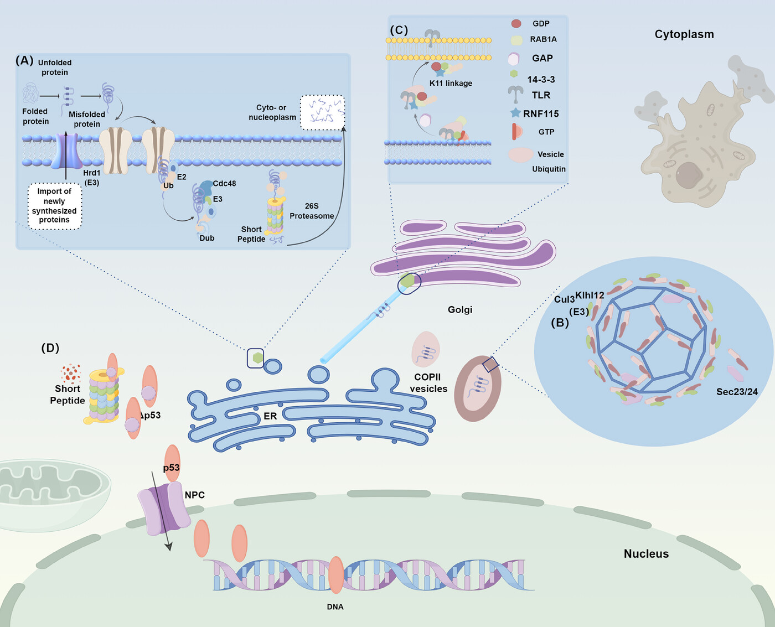
Ubiquitination
Ubiquitination: An enzymatic process involving the covalent attachment of ubiquitin to target proteins
  This modulates degradation, transportation, and signal transduction.
One critical function of ubiquitination is the regulation of protein trafficking and endosomal sorting.
Liao et al., Medcomm. (2025)

Slide 7
Liao et al., Medcomm. (2025)
Notes:
This is kinda close to what I study but one of the roles Ubiquitin plays is in the regulation of protein transport. So within the cell you have all of these compartments, called vesicles, which are separated by lipid bilayers, and these must be transported around as they contain cargo (such as protein or RNA) that performs some role. This is a schematic of some of that process and the role that Ubiquitin plays in transporting these proteins. So in A, Ubiquitin-mediated protein degradation ER involves tagging misfolded proteins for transport to the proteasome. This is important to restrict those proteins from getting out of the ER and messing up the cellular processes

Slide 8
Liao et al., Medcomm. (2025)
Notes:
Another example in that figure B on the right. Sec proteins are involved in regulating the secretion of certain proteins. Examples of this are like extracellular matrix proteins, which can get quite bulky. Vesicles are usually small, so they need something to help them accommodate/enlarge to fit these other proteins. So in this case, ubiquitination of a protein Cul3 facilitates the reorganization of COPII vesicles, allowing them to form larger vesicles capable of accommodating substrates

Slide 9
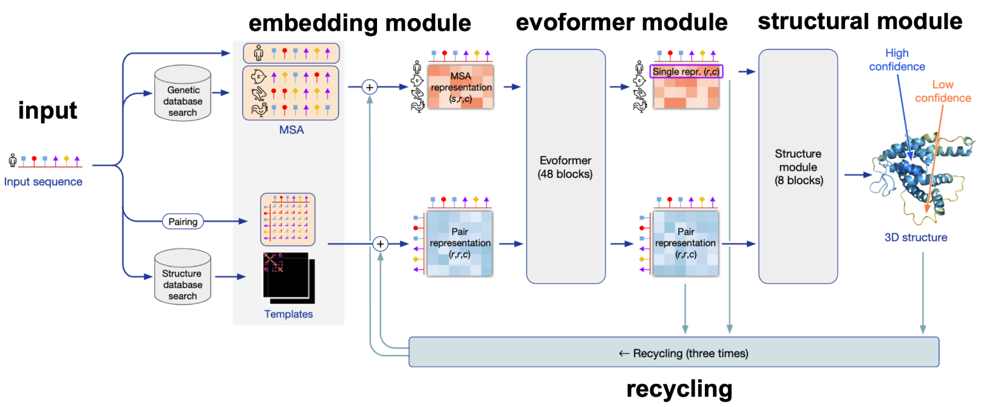
Notes:
I guess to bring it back to the goal of todays section, how does this relate to Alphafold 2 and such.
Input. The protein’s sequence goes in together with an alignment of related sequences found by searching large databases. The first row of the alignment is the input sequence itself.
Embedding. The inputs become two tables of numbers. The MSA representation has a row of numbers for each position of each sequence. The pair representation has numbers for every pair of residues.
Evoformer. 24 blocks, each of which updates the MSA and the pair representation.
Structural module. uses the tables to place every residue in 3D. This gives the structure, with a confidence color: blue is high, orange is low.

Slide 10

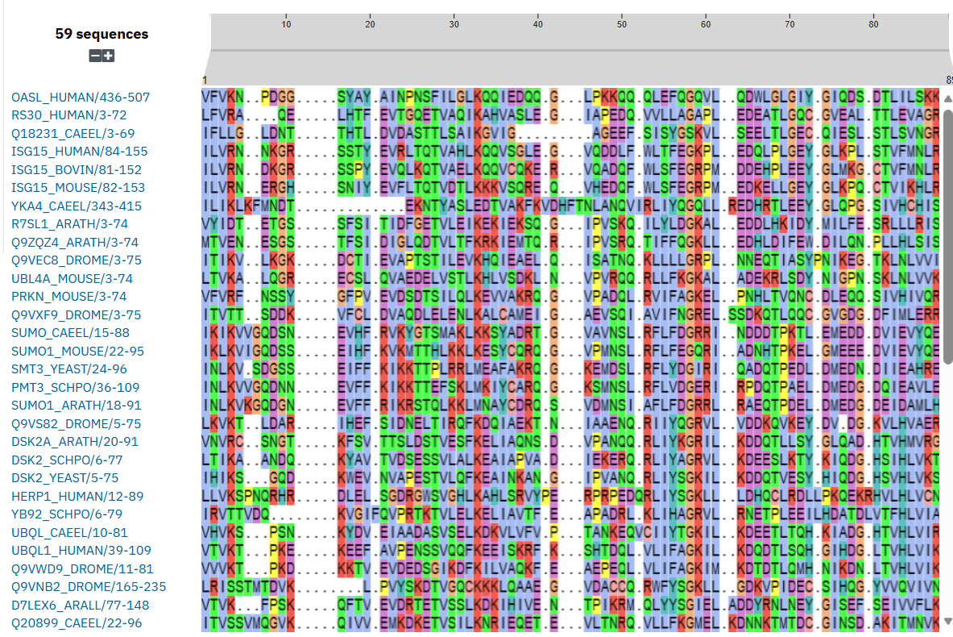
Ubiquitin Family MSA
Seed: 59 related sequences; any two share about 23% of their amino acids
Notes:
Pfam is a database of protein families, and PF00240 is the ubiquitin family. The 'seed' is the small hand-picked set of sequences Pfam uses to define the family: here, 59 sequences. Any two of them share only about 23% of their amino acids on average, so the set is diverse even though every sequence is related to ubiquitin. This is important because the differences between the sequences are what let us tell which positions stay the same across the whole family and which are free to change. Positions that never change are likely important for the protein’s structure or function.

Slide 11
2. Ubiquitin MSA
wtUb_seq = "MQIFVKTLTGKTITLEVEPSDTIENVKAKIQDKEGIPPDQQRLIFAGKQLEDGRTLSDYNIQKESTLHLVLRLRGG"
with open(UBIQUITIN_MSA_PATH) as f:
seqs = [line.strip() for line in f if line.strip() and not line.startswith(">")]
print("Shape of the msa", np.shape(np.array([list(seq) for seq in seqs])))
print("Do they match?", seqs[0] == wtUb_seq)
print("\nFirst 5 rows of the msa:")
for i, seq in enumerate(seqs[:5]):
print(f"{i}: {seq}")
Notes:
The alignment file has already been prepared, so loading it is simple. The file is read into a list of strings, one per sequence, skipping the header lines. The cell prints the size, checks that row 0 is exactly ubiquitin, and prints the first five rows. Output: (60, 76), meaning 60 sequences with 76 positions each, and 'Do they match? True'. Row 0 is ubiquitin itself, and rows 1 to 4 are related sequences with gaps ('-') at the ends. As in AlphaFold, the first sequence is the query and every row is as long as the query.
How the file was prepared: the original Pfam seed alignment has 59 sequences, does not include ubiquitin itself, and is wider than ubiquitin (89 positions instead of 76). I lined ubiquitin up against the closest seed sequence (UBQ8_ARATH, about 84% identical), kept only the 76 positions that match ubiquitin's residues, and put ubiquitin on top as row 0. Residues 1, 2, 75 and 76 of ubiquitin fall outside the region Pfam covers, so every other sequence has a gap there.

Slide 12
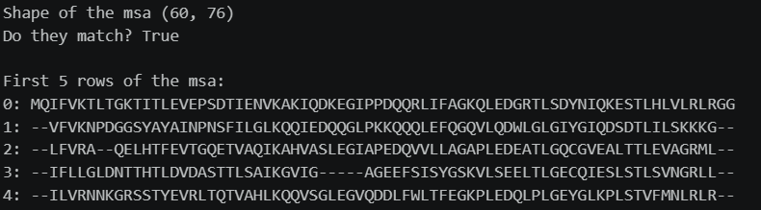
Ubiquitin Family MSA
Ubiquitin: MQIFVKTLTGKTITLEVEPSDTIENVKAKIQDKEGIPPDQQRLIFAGKQLEDGRTLSDYNIQKESTLHLVLRLRGG
Notes:
This is a multiple sequence alignment of the 59-sequence Pfam PF00240 seed

Slide 13
Notebook code · Cell 10: compare each row with ubiquitin
similarity_hist = []
min_sim_score = np.inf
max_sim_score = 0
count_matches_per_resi = np.zeros((len(wtUb_seq,)))
for i, seq in enumerate(seqs):
temp_counts_per_resi = np.zeros((len(wtUb_seq,)))
matching_idx = np.argwhere([aa == wtUb_seq[ai] for ai, aa in enumerate(seq)])
temp_counts_per_resi[matching_idx] = 1
similarity_score = np.sum(temp_counts_per_resi)/len(wtUb_seq)
count_matches_per_resi += temp_counts_per_resi
similarity_hist.append(similarity_score)
if similarity_score < min_sim_score:
min_sim_score = similarity_score
min_idx = i
if similarity_score > max_sim_score:
max_sim_score = similarity_score
max_idx = i
sorted_pos_counts = np.argsort(count_matches_per_resi)
print(f"Lowest position counts resi: {sorted_pos_counts[:5]+1} counts: {count_matches_per_resi[sorted_pos_counts[:5]]} aa: {[wtUb_seq[i] for i in sorted_pos_counts[:5]]}")
Notes:
This cell asks, for each sequence, how many of its positions are identical to ubiquitin (a gap counts as not identical), and divides by 76 to get a similarity score. It also counts, for each position, how many sequences have the same amino acid as ubiquitin there. Each position can match at most 60 times, because the alignment has 60 rows including ubiquitin itself. The cell prints the five positions with the lowest and the highest counts, and the least and most similar sequences. The histogram and bar chart on the next slide are drawn from these counts. Tall bars are conserved positions: the same amino acid in many sequences.

Slide 14
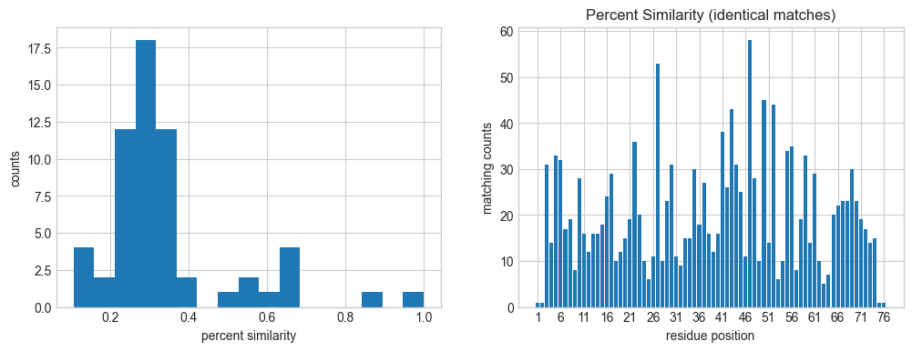
Sequence variation in the ubiquitin-centered MSA
59 Pfam seed sequences plus wild-type ubiquitin · 60 sequences × 76 positions
Notes:
The left panel is a histogram: for each of the 59 seed sequences, the share of positions that are identical to ubiquitin. The right panel counts, for each of the 76 positions, how many of the 60 sequences (including ubiquitin) have the same amino acid as ubiquitin there. Tall bars are conserved positions, the same in many sequences; short bars are positions that vary a lot.
Get it down what the MSA does that I useful to the later parts and put here
What the alignment gives the model: the lecture's point is that an alignment carries two kinds of information. It tells you about the species the sequences come from, and the pattern along the alignment, which positions stay the same and which change together, reveals structural information about the molecule. In AlphaFold the alignment is one of the two inputs (the other is the query sequence itself), and the model later looks at it in two ways: along each row, to learn how positions within one sequence relate to each other, which should capture structure; and down each column, comparing the same position across sequences, which should capture species-specific information. Here we first test one simple statistic on it (mutual information), and then give it to the model.

Slide 15
Notebook code · Cell 11: reference structure (1UBQ)
pdb_file_path = rcsb.fetch("1ubq", "pdb", gettempdir())
pdb_file = pdb.PDBFile.read(pdb_file_path)
pdb_file_str = str(pdb_file).split("\n")
ubq_pdb = pdb_file.get_structure(model=1)
# print some of the atom coordinates
atom_start_line = 307
for i in range(4):
aa_mask = struc.filter_amino_acids(ubq_pdb)
amino_acids = ubq_pdb[aa_mask]
ca_mask = amino_acids.atom_name == "CA"
ref_coords_ca = amino_acids.coord[ca_mask]
Notes:
This cell downloads the experimental structure of ubiquitin (PDB entry 1UBQ) and reads it. It prints four atom lines from the file just to show what it looks like. It then keeps one atom per residue, the alpha-carbon (CA), the central atom of each amino acid's backbone. We kinda use it as the answer key: first to build the true distance and contact maps, and at the end to compare with the predicted structure.

Slide 16
Notebook code · Cell 12: turn the alignment into numbers
def _build_alphabet(msa, alphabet=None):
if len(msa) == 0:
raise ValueError("msa must contain at least one sequence")
L = len(msa[0])
if any(len(seq) != L for seq in msa):
raise ValueError("All sequences in msa must have the same length")
if alphabet is None:
alphabet = sorted(set("".join(msa)))
else:
alphabet = list(alphabet)
char_to_idx = {c: i for i, c in enumerate(alphabet)}
for seq in msa:
for c in seq:
if c not in char_to_idx:
raise ValueError(f"Character {c!r} found in msa but not in alphabet")
return alphabet, char_to_idx
def _msa_to_int(msa, char_to_idx):
n_seq = len(msa)
L = len(msa[0])
msa_int = np.empty((n_seq, L), dtype=np.int32)
for n, seq in enumerate(msa):
msa_int[n] = [char_to_idx[c] for c in seq]
return msa_int
Notes:
These are helper functions that get the alignment ready for the mutual information calculation. Build alphabet just makes the list of symbols that appear in the alignment, the 20 amino acids plus the gap symbol (21 in all), and gives each symbol a number. Msa to int uses that list to replace every letter in the alignment with its number, so the alignment becomes a table of numbers with one row per sequence and one column per position. This is not yet the 'one-hot' encoding used for the model; that comes later.

Slide 17
Notebook code · Cell 12: mutual information
def compute_mi(msa, pseudocount=1e-3, alphabet=None):
alphabet, char_to_idx = _build_alphabet(msa, alphabet=alphabet)
msa_int = _msa_to_int(msa, char_to_idx)
n_seq, L = msa_int.shape
q = len(alphabet)
# Single-site frequencies fi[i, a]
fi = np.zeros((L, q), dtype=np.float64)
for i in range(L):
counts = np.bincount(msa_int[:, i], minlength=q)
fi[i] = counts / n_seq
fi = (1 - pseudocount) * fi + pseudocount / q
# Pair frequencies fij[i, j, a, b]
fij = np.zeros((L, L, q, q), dtype=np.float64)
for i in range(L):
xi = msa_int[:, i]
for j in range(L):
xj = msa_int[:, j]
pair_idx = xi * q + xj
counts = np.bincount(pair_idx, minlength=q * q).reshape(q, q)
fij[i, j] = counts / n_seq
fij = (1 - pseudocount) * fij + pseudocount / (q * q)
mi = np.zeros((L, L), dtype=np.float64)
for i in range(L):
for j in range(L):
pij = fij[i, j]
pi = fi[i][:, None]
pj = fi[j][None, :]
mi[i, j] = np.sum(pij * np.log((pij + 1e-12) / (pi * pj + 1e-12)))
return mi
Notes:
So then we use mutual information, which measures whether two positions in the alignment change together. The idea, generally, is that protein structure leaves a signature of covariation between interacting residues: if two residues touch in 3D, a change at one position tends to be matched by a change at the other. If knowing the amino acid at one position helps you guess the amino acid at another, that pair scores high. If it tells you nothing, the pair scores near zero.
To measure this, the code counts how often each amino acid appears at each position, and how often each pair of amino acids appears together at each pair of positions. For each pair of positions it compares the real pair counts with what you would expect by chance if the two positions were unrelated. The further the real counts are from chance, the higher the score. It also adds a small amount to every count so that none is exactly zero.

Slide 18
Notebook code · Cells 12-13: score pairs, skip edge positions
def top_pairs(score_map, top_k=12, min_sep=4):
pairs = []
L = score_map.shape[0]
for i in range(L):
for j in range(i + min_sep, L):
pairs.append((score_map[i, j], i, j))
pairs.sort(reverse=True)
return pairs[:top_k]
msa_subset = np.array(seqs)
mi = compute_mi(msa_subset)
coverage = np.mean(np.array([list(s) for s in msa_subset]) != "-", axis=0)
low_coverage = coverage < 0.5
print("Masked low-coverage columns (residue numbers):", np.where(low_coverage)[0] + 1)
mi[low_coverage, :] = 0.0
mi[:, low_coverage] = 0.0
Notes:
top_pairs ranks pairs of positions by score, and ignores pairs closer than four positions along the chain, because neighbors in the sequence are close in space anyway. The rest of the cell calculates mutual information for the whole alignment.

Slide 19
Notebook code · Cell 14: compare scores with the structure
ref_dmap = np.linalg.norm(ref_coords_ca[:, None, :] - ref_coords_ca[None, :, :], axis=-1)
ref_contact = (ref_dmap < 8.0).astype(float)
def upper_triangle_values(mat, min_sep=2):
mask = np.triu(np.ones_like(mat, dtype=bool), k=min_sep)
return mat[mask]
mi_contact_corr = np.corrcoef(upper_triangle_values(mi), upper_triangle_values(ref_contact))[0, 1]
mi_distance_corr = np.corrcoef(upper_triangle_values(mi), upper_triangle_values(-ref_dmap))[0, 1]
Notes:
This cell checks whether the mutual information scores match the real 3D structure. Using the 1UBQ coordinates, it builds two tables for every pair of residues: how far apart they are, and whether they touch (closer than 8 ångström). It then computes a correlation between each table and the mutual information scores. A correlation runs from -1 to 1, and 0 means no relationship. If the scores worked, high-scoring pairs would be the ones that touch.

Slide 20
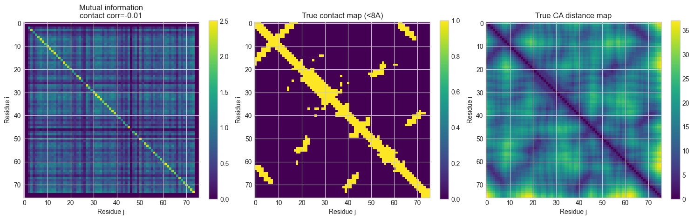
Notes:
Left: the mutual information map. Middle: the experimental contact map. Right: the true distance map between alpha-carbons. The correlations are essentially zero: -0.015 against contacts and 0.041 against negative distance. With only 60 sequences, the covariation signature the lecture describes is too weak to see with this simple statistic, so the model must be using the alignment in a more powerful way. The dark rows and columns at the edges are the ignored positions.

Slide 21
Notebook code · Cells 16-19: turn the sequences into numbers
# --- Cell 16: one-hot encode the query ---
# to encode the msa we one hot enocde the sequences
# the order is arbitrary and set by _restypes = ["A","R","N","D","C", "Q", "E", "G", "H", "I", "L", "K", "M", "F", "P", "S", "T", "W", "Y", "V",]
from feature_extraction.feature_extraction import onehot_encode_aa_type
enc1 = onehot_encode_aa_type(wtUb_seq, include_gap_token=False)
print("Shape of the one hot encode ubiquitin protein sequence:", np.shape(enc1))
# --- Cell 17: starting tensors for the whole MSA ---
from feature_extraction.feature_extraction import initial_data_from_seqs
features = initial_data_from_seqs(seqs)
for key, param in features.items():
print(key, np.shape(param))
# --- Cell 19: decode row 0 back to letters (round-trip check) ---
_restypes = ["A","R","N","D","C", "Q", "E", "G", "H", "I", "L", "K", "M", "F", "P", "S", "T", "W", "Y", "V",]
print("".join([_restypes[i] for i in np.argmax(features["msa_aatype"][0], axis=1)]))
Notes:
Now the alignment becomes numbers the model can read. One-hot encoding writes each residue as a list of zeros with a single 1 marking which amino acid it is (the lecture's example is a list of 20 for amino acids; here it is 21 or 22 because the codes also include unknown and, for the alignment, gap). Cell 16 does this for the query: size (76, 21), meaning 76 residues with 21 numbers each. Cell 17 does it for the whole alignment: (60, 76, 22), meaning 60 sequences, 76 positions, 22 numbers each. It also records how common each amino acid is at each position, and counts of inserted residues, which are all zero because the file marks none. Cell 19 turns row 0 back into letters as a check: the printed string equals ubiquitin.

Slide 22
Notebook code · Cell 21: choose rows, hide residues, trim extras
max_extra_msa_count=16
seed=0
features = initial_data_from_seqs(seqs)
features_clustered = select_cluster_centers(features.copy(), max_msa_clusters=32, seed=0)
features_mask_cluster = mask_cluster_centers(features_clustered.copy(), seed=0)
features_assignment = cluster_assignment(features_mask_cluster.copy())
features_summary = summarize_clusters(features_assignment.copy())
features_extra_msa = crop_extra_msa(features_summary.copy(), max_extra_msa_count=max_extra_msa_count, seed=seed + 2)
single_cycle = {
"msa_feat": calculate_msa_feat(features_extra_msa.copy()),
"extra_msa_feat": calculate_extra_msa_feat(features_extra_msa.copy()),
"target_feat": onehot_encode_aa_type(seqs[0], include_gap_token=False).float(),
"residue_index": torch.arange(len(seqs[0])),
"raw_sequences": seqs.copy(),
}
Notes:
Here the alignment is trimmed into the model’s input. Attention gets expensive as the number of sequences grows, so we cut down the number of rows.
Pick the main rows: the query plus randomly chosen sequences. A fixed seed makes the random picks repeatable. All other sequences become “extra” sequences.
Hide some residues: 15% of the residues in the main rows are chosen. Most of them (70%) are replaced by a “masked” symbol. The rest are swapped for a random amino acid (10%), swapped for a typical amino acid for that position (10%), or left alone (10%). In training, the model learns by filling these back in, which the lecture calls the MSA loss.
Assign each extra sequence to the main row it is most similar to.
Average each main row’s group into a summary.
Keep 16 of the extra sequences, chosen at random.

Slide 23
Notebook code · Cell 22: look at the model's inputs
feature_descriptions = {
"target_feat": "Per-residue query-sequence features",
"msa_feat": "Clustered MSA rows with sequence/deletion features",
"extra_msa_feat": "Extra homologs routed through the Extra MSA stack",
"residue_index": "Residue positions along the chain",
}
print("Feature tensors that go into the model:")
for key, value in single_cycle.items():
desc = feature_descriptions.get(key, "")
if key != "raw_sequences":
print(f"{key:>14}: {tuple(value.shape)} {desc}")
Notes:
This cell shows what was built, as the model's inputs. As in the lecture's, msa_feat and target_feat feed the MSA representation, target_feat also feeds the pair representation, and the extra sequences go on to update the pair representation. The two plots on the next slide show the query as a grid of 0s and 1s and the amino-acid summary of the first main row.

Slide 24
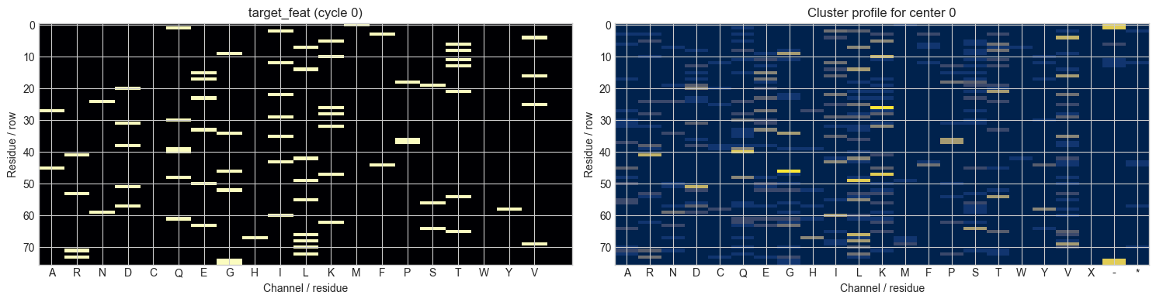
Notes:
These two pictures show what the model will receive. The left graph is the query sequence as one hot encoded. Each row is a residue, each column is an amino-acid type. To the right is, for the first main row, a summary of how common each amino acid is among the sequences grouped with it.

Slide 25
Notebook code · Cell 24: build the model's inputs
# imports: same names as in cell 21
def create_section_features_from_seqs(seqs, max_msa_clusters=16, max_extra_msa_count=16, seed=0):
features = initial_data_from_seqs(seqs.copy())
features = select_cluster_centers(features, max_msa_clusters=max_msa_clusters, seed=seed)
features = mask_cluster_centers(features, seed=seed + 1)
features = cluster_assignment(features)
features = summarize_clusters(features)
features = crop_extra_msa(features, max_extra_msa_count=max_extra_msa_count, seed=seed + 2)
return {
"msa_feat": calculate_msa_feat(features),
"extra_msa_feat": calculate_extra_msa_feat(features),
"target_feat": onehot_encode_aa_type(seqs[0], include_gap_token=False).float(),
"residue_index": torch.arange(len(seqs[0])),
"raw_sequences": seqs,
}
single_cycle = create_section_features_from_seqs(seqs, max_msa_clusters=16, max_extra_msa_count=16, seed=0)
batch = {
key: value.unsqueeze(-1).to(DEVICE)
for key, value in single_cycle.items()
if key != "raw_sequences"
}
print("Feature shapes for the one-cycle teaching batch:")
for key, value in batch.items():
print(f"{key:>14}: {tuple(value.shape)}")
Notes:
This wraps the same steps into one function, which is what the model actually uses. One pass/ the single cycle means no recycling. Usually you would do a few, in the lecture notes it was three I believe for Alphafold, but for the sake of this we are just doing one cycle

Slide 26
Notebook code · Cell 27: load the OpenFold weights (1/2)
from model.model import Model
from model.utils import load_openfold_weights
model = Model()
state_dict = load_openfold_weights(str(OPENFOLD_WEIGHT_PATH))
load_result = model.load_state_dict(state_dict, strict=False)
assert not load_result.missing_keys and not load_result.unexpected_keys
model = model.to(DEVICE).eval()
def summarize_msa_tensor(m):
return m[0, :, :48].detach().cpu().T
def summarize_pair_tensor(z):
return z.abs().mean(dim=-1).detach().cpu()
def print_value_slice(name, tensor, rows=4, cols=6):
array = tensor.detach().cpu()
print(f"\n{name} sample:")
print(array[:rows, :cols])
with torch.no_grad():
current_batch = {key: value[..., 0] for key, value in batch.items()}
n_seq, n_res = current_batch["msa_feat"].shape[:2]
prev_m = torch.zeros((n_seq, n_res, model.c_m), device=DEVICE)
prev_z = torch.zeros((n_res, n_res, model.c_z), device=DEVICE)
prev_x = torch.zeros((n_res, 3), device=DEVICE)
snapshots = {}
Notes:
Here we build the model and load OpenFold's trained weights, the numbers the model learned during training. The check straight after loading makes sure that every parameter in the file found a place in the model and none were left over; otherwise it stops with an error, instead of quietly running with random numbers. The model is set to prediction mode rather than training mode. The rest of the cell sets up the first pass: the 'previous pass' inputs are all zeros because this is the first and only pass.

Slide 27
Notebook code · Cell 27: embedding and Evoformer by hand (2/2)
# (inside the torch.no_grad() block from the previous slide)
m, z = model.input_embedder(current_batch)
m_rec, z_rec = model.recycling_embedder(prev_m, prev_z, prev_x)
m = m.clone()
m[0] = m[0] + m_rec
z = z + z_rec
e = model.extra_msa_embedder(current_batch)
z = model.extra_msa_stack(e, z)
checkpoint_names = {0: "Evoformer 1", 11: "Evoformer 12", 23: "Evoformer 24"}
for block_idx, block in enumerate(model.evoformer.blocks):
m, z = block(m, z)
if block_idx in checkpoint_names:
snapshots[checkpoint_names[block_idx]] = (m.detach().cpu(), z.detach().cpu())
print("Loaded OpenFold weights into alphafold-decoded.")
for name, (m_snap, z_snap) in snapshots.items():
print(f"{name:>16}: m {tuple(m_snap.shape)}, z {tuple(z_snap.shape)}")
first_name = next(iter(snapshots))
first_m, first_z = snapshots[first_name]
print_value_slice("m[0, residues, channels]", first_m[0])
print_value_slice("z[res_i, res_j, channels]", first_z[0])
Notes:
Now we run the first stages of the model by hand. The embedding step turns the inputs into two tables of numbers: the MSA representation m, with 256 numbers for every position of every row (size 16 by 76 by 256), and the pair representation z, with 128 numbers for every pair of positions (size 76 by 76 by 128). The pair table is built from the query sequence and includes how far apart the two residues are along the chain, capped at 32 in either direction.
The recycling step is where AlphaFold feeds the results of the previous pass back in. This is the first pass, so there is nothing to feed back and it adds essentially nothing. The extra-sequence stack then updates z using the extra sequences.
Then the 48 Evoformer blocks run. Each block updates both m and z, and the two exchange information: z gives a bias to the attention in m, and m updates z. A copy of m and z is saved after blocks 1, 12 and 24

Slide 28
Notebook code · Cell 28: plot m and z at blocks 1, 12 and 24
snapshot_names = list(snapshots.keys())
msa_mats = [summarize_msa_tensor(snapshots[name][0]) for name in snapshot_names]
pair_mats = [summarize_pair_tensor(snapshots[name][1]) for name in snapshot_names]
msa_vmin = min(m.min() for m in msa_mats)
msa_vmax = max(m.max() for m in msa_mats)
pair_vmin = min(m.min() for m in pair_mats)
pair_vmax = max(m.max() for m in pair_mats)/4
fig, axes = plt.subplots(2, len(snapshot_names), figsize=(3.4 * len(snapshot_names) + 1.5, 6), constrained_layout=True)
for col, name in enumerate(snapshot_names):
m_snap, z_snap = snapshots[name]
msa_rep_heatmap = axes[0, col].imshow(summarize_msa_tensor(m_snap), aspect="auto", cmap="coolwarm", vmin=msa_vmin, vmax=msa_vmax)
axes[0, col].set_title(name, fontsize=10)
axes[0, col].set_xlabel("Residue")
axes[0, col].set_ylabel("First 48 m channels")
pair_rep_heatmap = axes[1, col].imshow(summarize_pair_tensor(z_snap), cmap="viridis", vmin=pair_vmin, vmax=pair_vmax)
axes[1, col].set_title(name, fontsize=10)
axes[1, col].set_xlabel("Residue j")
axes[1, col].set_ylabel("Residue i")
Notes:
This cell turns the saved copies into graphs. The top row shows the first 48 of the 256 numbers for each position in the first row of m (the query's row). The bottom row shows the average size of the 128 numbers for each pair of positions in z, as a 76 by 76 map.

Slide 29
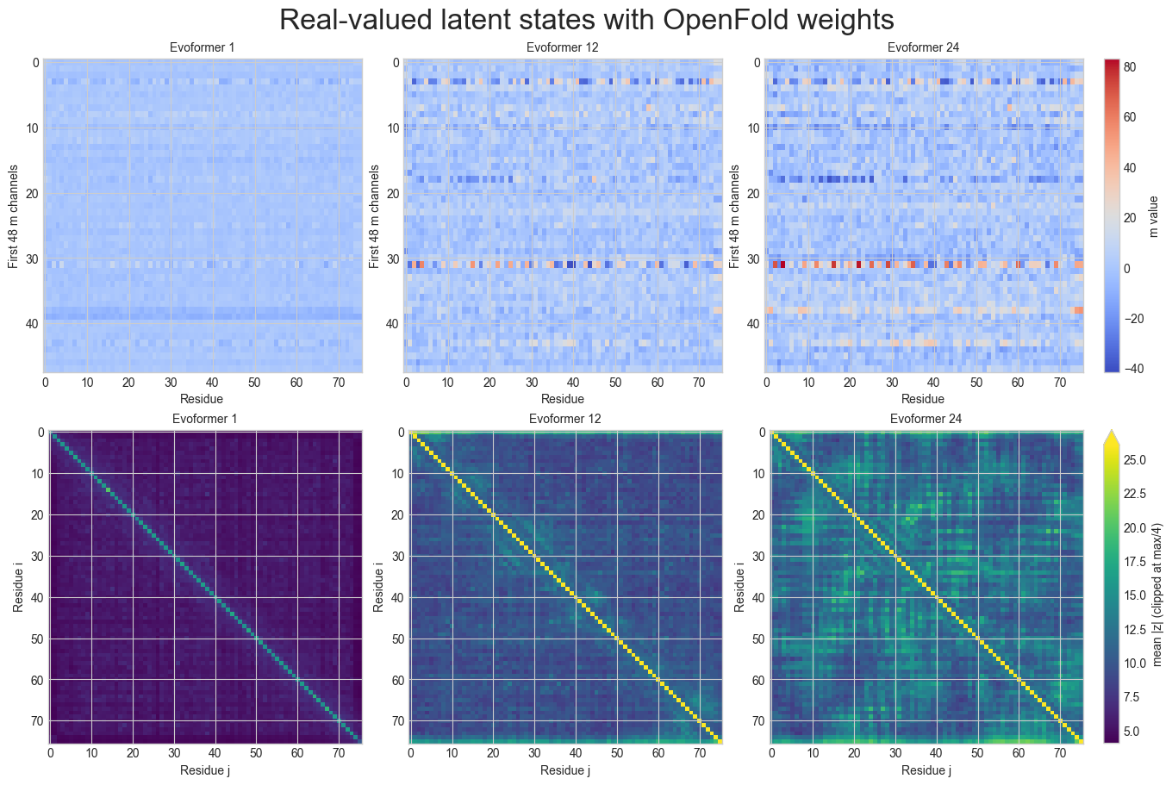
Notes:
The MSA representation m builds up a pattern from block 1 to block 24. The pair representation z builds up a strong diagonal, which is expected because residues close in sequence are usually close in space, and the signal away from the diagonal also builds up.

Slide 30
Notebook code · Cells 30-31: one attention module, small slice
# Pick a real block after you've already computed m and z
row_att = model.evoformer.blocks[0].msa_att_row
row_att.eval()
# Small real slice for example
n_res_demo = 8
m_demo = m[:1, :n_res_demo, :].detach().cpu() # first MSA row only
z_demo = z[:n_res_demo, :n_res_demo, :].detach().cpu() # matching pair slice
print("m_demo", m_demo.shape)
print("z_demo", z_demo.shape)
for name, param in row_att.named_parameters():
if "weight" in name or "bias" in name:
print(name, tuple(param.shape))
Notes:
Now we will look at a single Evoformer block.
Attention lets each position look at the other positions and decide which ones matter for it. In row attention, each position looks at the other positions in the same sequence, this captures structural information. The pair table nudges the attention by adding a bias to the scores.
To keep it small, we use block 1’s attention module on a slice of the data: the query’s row for 8 residues, plus the matching 8 by 8 piece of the pair table. The slice actually comes from the end of the model (after block 48), so this shows how the step works, not exactly what block 1 does.
Cell 31 then lists the numbers the module has learned, such as the weights for queries, keys and values and for the pair bias.

Slide 31
Notebook code · Cells 32-34: normalize, then queries, keys, values
attn = row_att.mha
head = 0
# 1. Normalize / prepare exactly as the module does
m_in = row_att.layer_norm_m(m_demo)
z_in = row_att.layer_norm_z(z_demo)
print("m_in", np.shape(m_in))
print("m_in mean", np.mean(m_in[0,:,:].detach().numpy(), axis=-1))
print("m_in per-residue stds:", m_in[0].detach().cpu().numpy().std(axis=-1))
# 2. Linear projections
q = attn.linear_q(m_in)
k = attn.linear_k(m_in)
v = attn.linear_v(m_in)
print("q shape", np.shape(q))
print("k shape", np.shape(q))
print("v shape", np.shape(q))
Wq = attn.linear_q.weight
print("Wq shape", np.shape(Wq))
Notes:
Cell 32 picks head 0 and normalizes the slice. Layer normalization shifts each residue's numbers so their average is zero and rescales them to a common; the printed averages and spreads before and after show this. Cell 33 then makes three versions of each residue: queries, keys and values, each of size (1, 8, 256). In the lecture's picture, queries and keys 'talk to each other' to produce the attention map, and the values carry the result forward to produce the output.

Slide 32
Notebook code · Cell 36: split into attention heads
n_head = attn.N_head
print("n_head", n_head)
print("q", np.shape(q))
c_head = q.shape[-1] // n_head
print(f"{q.shape[-1]}//{n_head} =", c_head)
qh = q.view(*q.shape[:-1], n_head, c_head)
kh = k.view(*k.shape[:-1], n_head, c_head)
vh = v.view(*v.shape[:-1], n_head, c_head)
print("qh", np.shape(qh))
print("kh", np.shape(kh))
print("qh", np.shape(vh))
Notes:
The queries, keys and values from the previous slide each hold 256 numbers per residue. Cell 36 splits these into 8 heads of 32 numbers each. Multi-head attention means running several attention calculations side by side, each with its own queries, keys and values, so that each can focus on a different relationship; the results are joined back together afterwards. The printed sizes at each step, such as (1, 8, 8, 32), show the split.

Slide 33
Notebook code · Cells 36-38: scores, pair bias, attention weights
q_h = qh[0, :, head, :] # [N_res, c_head]
k_h = kh[0, :, head, :]
v_h = vh[0, :, head, :]
print("q_h", np.shape(q_h))
print("k_h",np.shape(k_h))
print("v_h",np.shape(v_h))
# 4. Pair bias term from z
pair_bias = row_att.linear_z(z_in)[:, :, head] # [N_res, N_res]
# 5. Raw attention scores
scores = (q_h @ k_h.T) / math.sqrt(c_head)
scores_with_bias = scores + pair_bias
# 6. Attention weights
alpha = torch.softmax(scores_with_bias, dim=-1)
# 7. Weighted value sum
out_head = alpha @ v_h
Notes:
We keep head 0 and the first row, so the queries, keys and values are each 8 by 32. The score for a pair of residues is how well one residue's query matches the other's key (a dot product), divided by the square root of 32 so that the largest values do not dominate, as in the lecture. The pair bias comes from z: it is normalized, and a small layer turns each pair's 128 numbers into one number per head, which is added to the score. This is how the pair representation steers the MSA's attention.
Softmax then turns each row of scores into attention weights

Slide 34
Notebook code · Cells 41-42: run the full model, align (1/2)
with torch.no_grad(), contextlib.redirect_stdout(io.StringIO()):
outputs = model(batch)
final_positions = outputs["final_positions"][..., 0].detach().cpu()
ca_idx = atom_types.index("CA")
ca_positions = final_positions[:, ca_idx, :]
ca_distances = torch.cdist(ca_positions, ca_positions)
def centroid(coords):
return np.mean(coords, axis=0)
def kabsch_rotation_matrix(A, B):
C = np.dot(np.transpose(A), B)
V, S, Wt = np.linalg.svd(C)
d = (np.linalg.det(V) * np.linalg.det(Wt)) < 0.0
if d:
S[-1] = -S[-1]
V[:,-1] = -V[:,-1]
U = np.dot(V, Wt)
return U
Notes:
Now for the full prediction. model(batch) runs the whole AlphaFold pipeline for one pass: embedding, the extra-sequence stack, the 48 Evoformer blocks and the structure module. The structure module takes the first row of the MSA representation, the pair representation, and a position and orientation for each residue, which all start at the same point. Over 8 repeated steps it uses Invariant point attention to move each residue into place; it also predicts torsion angles that fix the positions of the remaining atoms.
We then take the alpha-carbon (CA) of each residue, the central atom of its backbone, and compute the 76 by 76 table of distances between every pair of predicted CA atoms

Slide 35
Notebook code · Cells 42-43: align, then measure the error (2/2)
def rmsd(A, B):
return np.sqrt(np.mean(np.sum((A - B)**2, axis=1)))
def align(A, B):
centroid_A = centroid(A)
centroid_B = centroid(B)
A2 = A.copy()
B2 = B.copy()
A2 -= centroid_A
B2 -= centroid_B
U = kabsch_rotation_matrix(A2, B2)
A_rotated = np.dot(A2, U)
return rmsd(A_rotated, B2), A_rotated + centroid_B
calculated_rmsd, ca_positions_rotated = align(ca_positions.numpy(), ref_coords_ca)
print(f"RMSD: {calculated_rmsd}")
Notes:
To compare the prediction with the experimental structure we first overlay them we will shift both to a common center, then rotate the prediction onto the experimental structure as closely as possible. Rmsd then measures the average distance between matching CA atoms after the overlay, in angstrom. RMSD stands for root-mean-square deviation, a kind of average distance; smaller is better. Running it on the predicted and 1UBQ CA coordinates gives 0.84 angstrom for this run. The plotting code is omitted here; the figure is on the next slide.

Slide 36
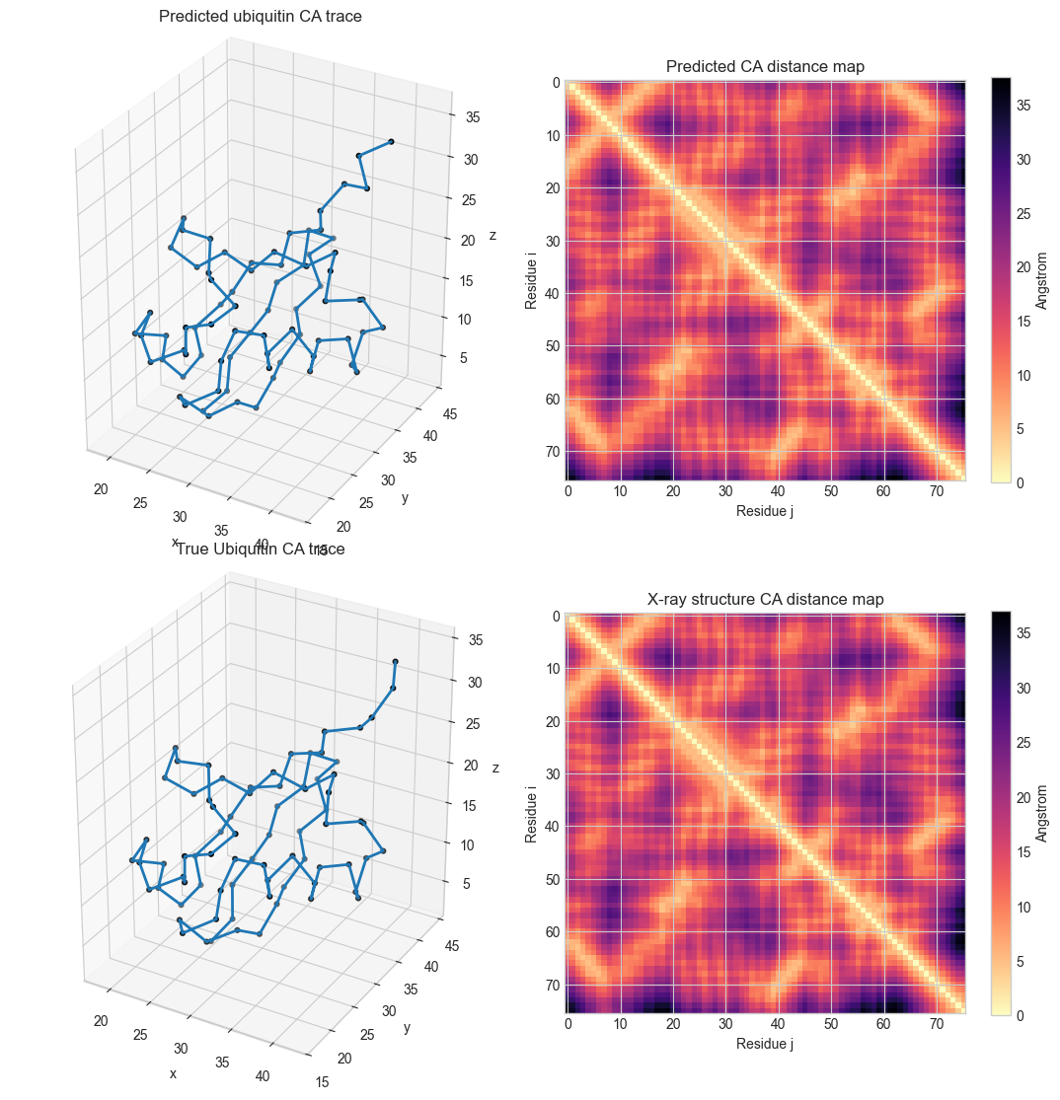
Predicted:
Ubiquitin
True structure:
Ubiquitin
Notes:
Top row: the predicted CA trace (the approximate shape of the protein's backbone) and the predicted CA distance map. Bottom row: the experimental structure and its distance map. After overlaying, the RMSD is 0.84 angstrom. As before, residues close together in the chain are close in space, hence the diagonal, but the map also shows other residues nearby, which can be seen on the trace.

Slide 37
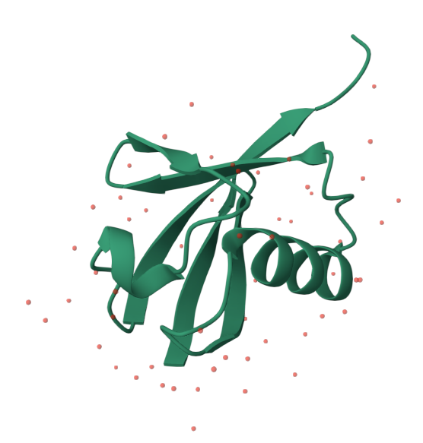
Alphafold:
Ubiquitin
Protein Data Bank:
Ubiquitin
Predicted:
Ubiquitin
Notes:
The C-terminal tail is flexible making it the hardest part to predict

